Slide 1

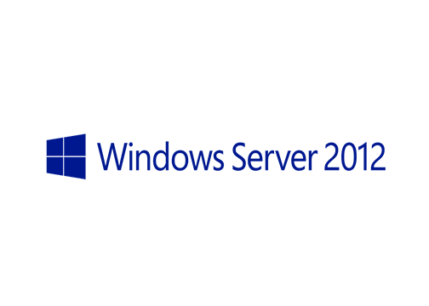
MegaSeries
Hyper-V Live Migration

Slide 2
Info
Move a running VM from a Hyper-V server to another one without shutting the VM down and with minimal connectivity loss (maybe 1 or 2 pings depending on the migration type)

Slide 3
Migration types
Live migration in a failover cluster
Live migration with VM files stored on SMB share
Live storage migration
Shared nothing live migration

Slide 4
https://www.youtube.com/channel/UCcZ-jLbPwNr8E_v9-65n8Iw https://github.com/itknowledge4

